Slide 1
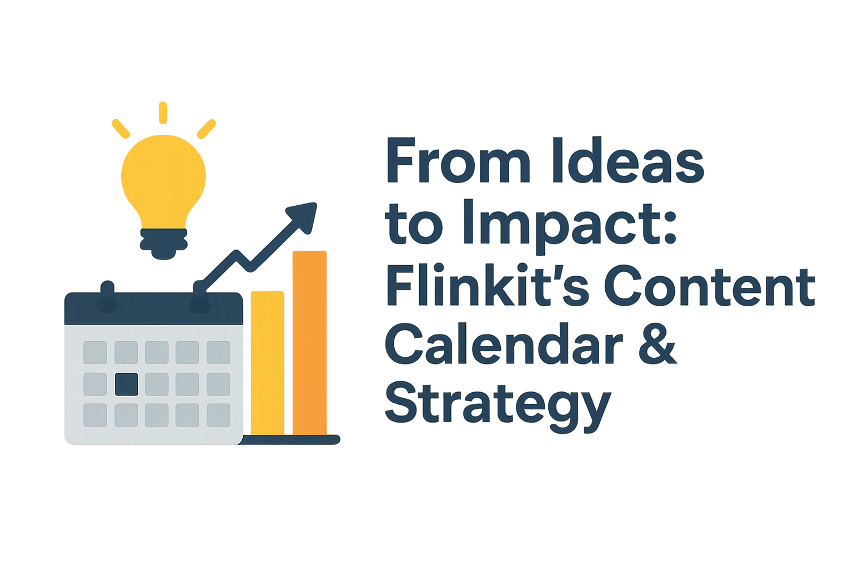


Slide 2
INSTRUCTIONS
How to use this template?
Click on "File" and then "Make a Copy" of the template to use it.
Edit each of the slides and table to add your responses.
Come up with a catchy title for the project and do not simply write "Minor Project 3: Search Engine Optimisation Strategy for FlinkIt".
Use the primary colours and logo of the assigned brands on the Cover Page and wherever necessary in the project.
Feel free to use your creativity to make the most use of the given template.
The maximum Number of Slides that can be used is 20.
Once you are happy with your responses, click on "Share", download it into a PDF file and submit it on the MyCaptain WebApp.

Slide 3
PROBLEM STATEMENT
Flinkit currently faces challenges in maintaining a structured, consistent, and impactful content approach. The absence of a well-defined content calendar and strategic framework results in irregular posting, limited audience engagement, and difficulty in aligning content with business objectives. Additionally, the lack of visualization tools makes it hard to track performance, measure outcomes, and identify gaps in the content journey from ideation to execution.
This project aims to solve these challenges by developing a comprehensive content calendar, defining a content strategy aligned with business goals, and implementing visualization methods to ensure measurable impact, improved brand consistency, and audience growth.

Slide 4
OBJECTIVES
1. Create a structured content calendar for consistency.
2. Align content with Flinkit’s business goals.
3. Boost audience engagement with relevant content.
4. Use visualization tools to track performance.
5. Improve team collaboration and efficiency.
6. Measure and optimize content impact using KPIs.

Slide 5
APPROACH
The project will adopt a structured, step-by-step approach beginning with an analysis of Flinkit’s current content practices and audience needs. A comprehensive content calendar will be designed to ensure consistency, while a content strategy framework will be developed to align with business objectives. Visualization tools such as dashboards and performance trackers will be implemented to monitor impact, identify gaps, and guide continuous optimization. The approach emphasizes collaboration, data-driven decision-making, and scalability to ensure sustainable content growth and improved audience engagement.

Slide 6
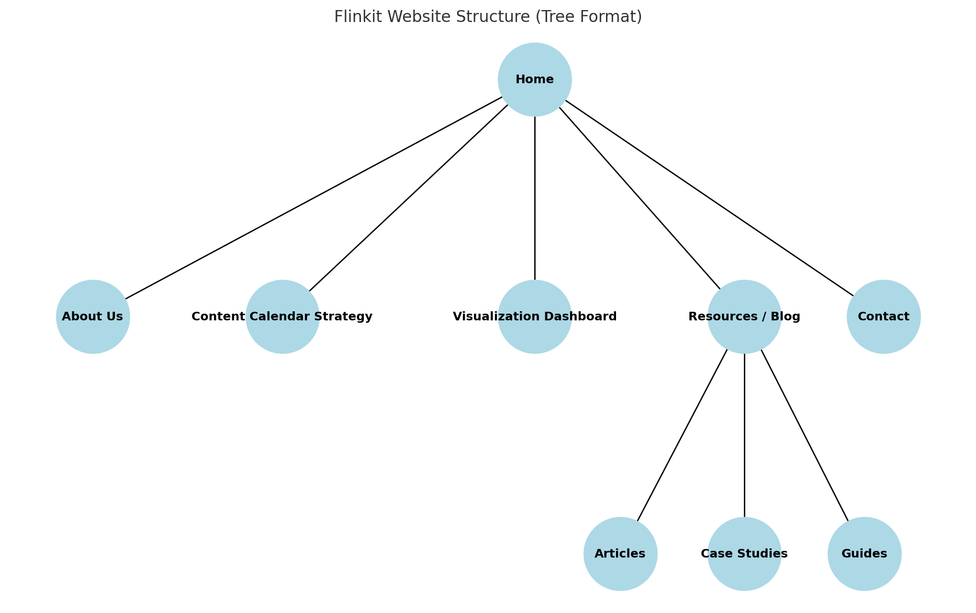
TASK 1 - CREATE A WEBSITE STRUCTURE

Slide 7
TASK 2 - TOPIC IDEAS
From Brainstorming to Execution: How Flinkit Turns Ideas into Measurable Impact
Why a Content Calendar is the Bridge Between Ideas and Business Growth
The Role of Visualization in Transforming Content Strategy into Results
From Chaos to Clarity: Building an Effective Content Calendar with Flinkit
How Flinkit’s Content Strategy Drives Consistency, Engagement, and ROI
The Journey of an Idea: Mapping Concepts into Campaigns with Flinkit
Data-Driven Storytelling: Turning Content Plans into Tangible Impact
Content Strategy Made Simple: From Ideation to Execution with Flinkit
Maximizing Team Collaboration Through a Unified Content Calendar
Impact That Lasts: How Strategic Planning Shapes Long-Term Brand Success

Slide 8
TASK 3 - PICKING UP THE PAGES
Why Every Brand Needs a Content Calendar
Topics :
Importance of consistency in content publishing
How a content calendar saves time & resources
Examples of successful brands using calendars
Step-by-step guide to creating one
Tools (like Flinkit) that make content planning easier

Slide 9
TASK 3 - PICKING UP THE PAGES
Why Every Brand Needs a Content Calendar
Topics :
Importance of consistency in content publishing
How a content calendar saves time & resources
Examples of successful brands using calendars
Step-by-step guide to creating one
Tools (like Flinkit) that make content planning easier

Slide 10
Content Calendar Tool
Drag & drop scheduling
Multi-platform publishing (social + blog + campaigns)
AI-powered suggestions for timing & topics
Team collaboration & approval workflows
Mobile & desktop friendly interface
CTA: “Start Your Free Trial

Slide 11
Analytics & Visualization
Real-time dashboards for campaign tracking
KPI monitoring (engagement, reach, conversions)
Customizable charts & reports
How visualization helps in data-driven decision-making
Integration with other marketing tools
CTA: “Explore Analytics Tools”

Slide 12
TASK 4 - CONTENT STRUCTURE
1. Blog Page – Why Every Brand Needs a Content Calendar
Header: Title, intro, image
Intro: What is a content calendar & why it matters
Body: Benefits → Problems without it → Steps to create one
Flinkit’s Role: Tool features & screenshot
Conclusion: Recap + CTA
2. Product Page – Content Calendar Tool
Hero: Product name, tagline, CTA
Features: Drag & drop, multi-platform, collaboration, AI-suggestions
Benefits: Save time, brand consistency, productivity
Visuals: Demo / screenshots
Social Proof: Testimonials / case study
CTA: Pricing + Free Trial
3. Product Category Page – Analytics & Visualization
Header: Title + dashboard image
Sub-Tools: Dashboards, KPIs, reports, campaign analytics
Why It Matters: Data-driven decisions
Flinkit’s Solution: Features + integrations
Use Cases: Marketers, startups, agencies
CTA: Explore Tools

Slide 13
Flinkit competes with CoSchedule, Asana, monday.com, Canva, and Adobe Express, plus editorial listicles (TechRadar, TheCMO, BloggingWizard). Competitors dominate with social scheduling, project workflows, free schedulers, and template libraries. Strengths of competitors: strong brand authority, feature depth, and template coverage. Weaknesses: lack of focus on visualization, deep analytics, and AI-driven planning. Keyword gaps & opportunities for Flinkit: “Marketing calendar templates” (Google Sheets, Excel, Notion variants) “Free content calendar / free scheduler” “Content analytics dashboard / KPI templates” “AI content calendar generator / AI posting suggestions”
TASK 5 - COMPETITIVE ANALYSIS

Slide 14
1. Product Page – Content Calendar Tool content calendar tool content calendar software editorial calendar software AI-powered content calendar multi-platform publishing calendar 2. Product Category Page – Marketing Calendar Templates marketing calendar templates content calendar templates free content calendar template social media content calendar template Google Sheets content calendar 3. Blog Page – Content Analytics Dashboard content analytics dashboard content performance dashboard content KPI dashboard campaign performance visualization editorial calendar analytics
TASK 6 - KEYWORD RESEARCH

Slide 15
TASK 7 - ON-PAGE ELEMENTS
On-page SEO includes meta title, meta description, clean URL, proper headings (H1–H3), keyword-optimized content, internal linking, image alt text, mobile-friendly design, fast loading speed, schema markup, CTA buttons, easy navigation, canonical tags, and social sharing tags (OG/Twitter Cards). It ensures pages are search-friendly, user-friendly, and optimized for higher rankings.

Slide 16
In today’s digital-first world, content performance is just as important as content creation. Brands publish hundreds of posts, videos, and campaigns, but without proper tracking, it’s impossible to know what works. That’s where a Content Analytics Dashboard comes in. A content analytics dashboard is a centralized tool that helps marketers and businesses track the success of their campaigns. From content KPIs like reach, engagement, and conversions to deeper insights such as audience behavior and channel performance, it ensures you are measuring what truly matters. Why do you need a content analytics dashboard? Traditional reports can be time-consuming and scattered across multiple platforms. A dashboard integrates data from different sources—social media, blogs, email campaigns, and paid ads—into a single, real-time performance dashboard. This saves time and improves decision-making. Key features to look for in a strong dashboard include customizable metrics, visual reporting, campaign comparisons, and integration with popular platforms. For example, a marketing team may want to compare how a blog post performs against a LinkedIn campaign or how email clicks translate into website traffic. At Flinkit, our content analytics dashboard goes beyond numbers. With AI-driven insights and easy-to-read visualization tools, it helps marketers identify gaps, optimize their content strategy, and improve ROI. Whether you’re planning a new campaign or refining your content calendar, the dashboard gives you a clear picture of what’s working.
TASK 8 - EXAMPLE BLOG

Slide 17
CONCLUSION AND TAKEAWAYS
Creating optimized content calendars aligned with user intent and trending keywords.
Using keyword research and competitive analysis to design campaigns that outperform competitors.
Implementing on-page SEO practices (titles, meta tags, internal linking, schema) to improve ranking and CTR.
Building SEO-driven blogs, product pages, and category pages that not only rank but also convert.
Tracking results through analytics dashboards and refining strategies based on performance.

